Slide 1
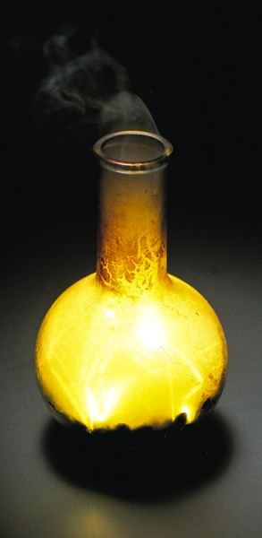
Chapter 10: The Periodic Table and Some Atomic Properties
General Chemistry
Principles and Modern Applications
Petrucci • Harwood • Herring
8th Edition
Philip Dutton
University of Windsor, Canada
Prentice-Hall © 2002
Notes:
Thermochemistry branch of chemistry concerned with heat effects accompanying chemical reactions.
Direct and indirect measurement of heat.
Answer practical questions: why is natural gas a better fuel than coal, and why do fats have higher energy value than carbohydrates and protiens.

Slide 2
Contents
10-1 Classifying the Elements: The Periodic Law and the Periodic Table
10-2 Metals and Nonmetals and Their Ions
10-3 The Sizes of Atoms and Ions
10-4 Ionization Energy
10-5 Electron Affinity
10-6 Magnetic Properties
10-7 Periodic Properties of the Elements
Focus on The Periodic Law and Mercury

Slide 3
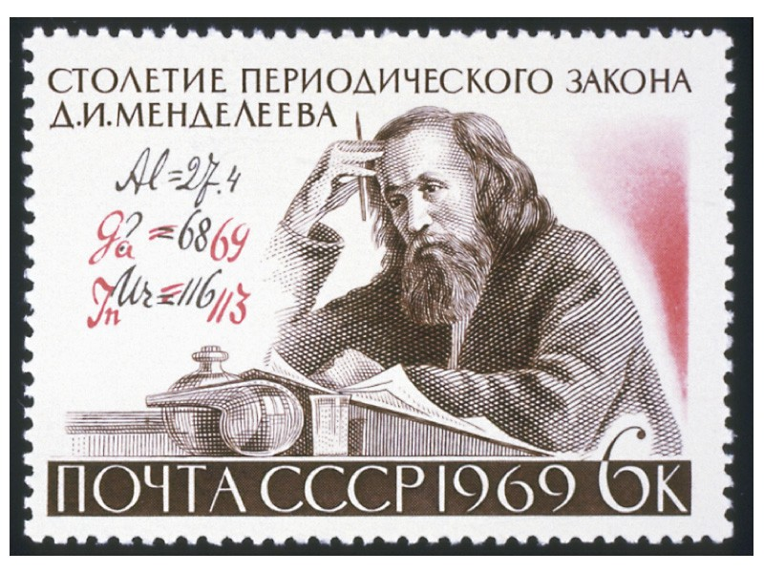
10-1 Classifying the Elements: The Periodic Law and the Periodic Table
1869, Dimitri Mendeleev
Lother Meyer
When the elements are arranged in order of increasing atomic mass, certain sets of properties recur periodically.

Slide 4
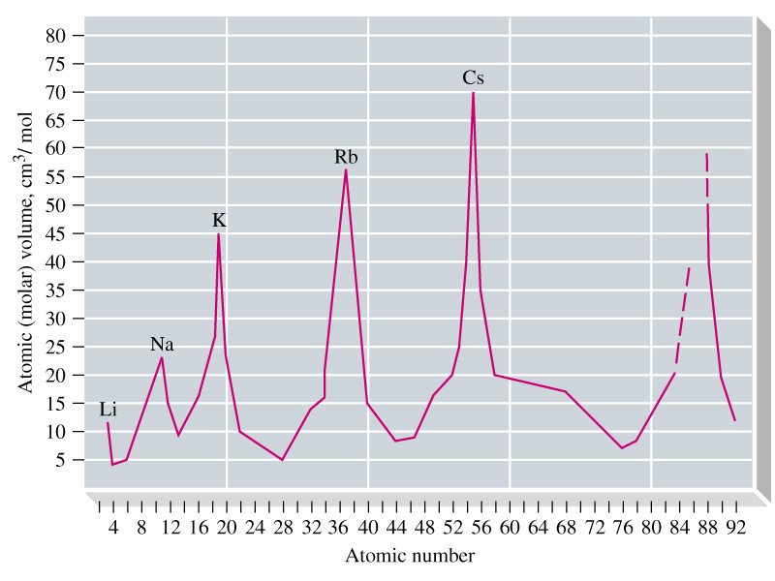
Periodic Law
Notes:
Meyer based his law on atomic volume, the atomic mass divided by density of solid.
He later examined other physical properties such as
Hardness
Compressibility
Boiling point
And found these also behaved periodically.

Slide 5
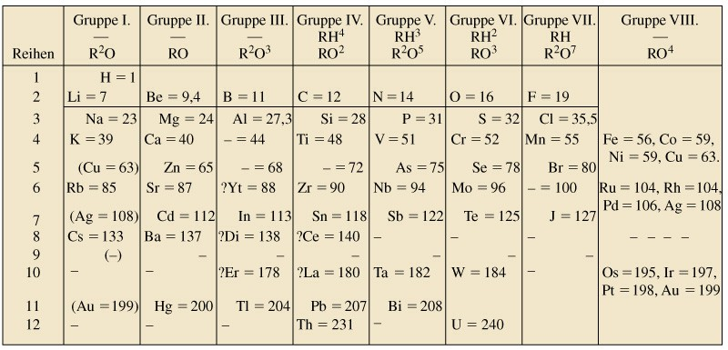
Mendeleev’s Periodic Table
1871
— = 44
— = 68
— = 72
— = 100
Notes:
Mendeleev’s work attracted more attention
He left blank spadces in his table, at 44, 68, 72, and 100, for undiscovered elements (Sc Ga Ge Tc)
He corrected some atomic mass values (In, U).
Group 1 has high molar volume, low melting points and all form M⁺ ions.

Slide 6
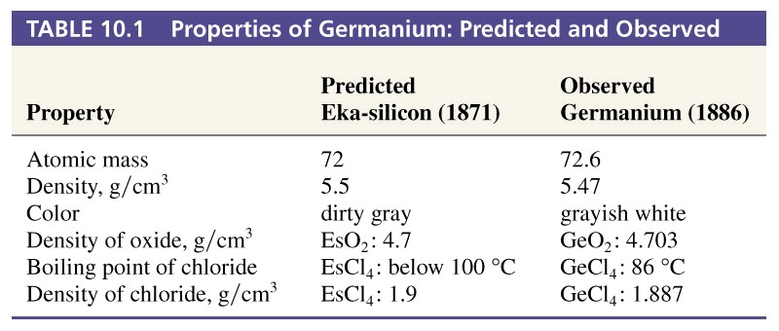
Predicted Elements were Found
Notes:
Other additions to the table included the Noble gases discoved by William Ramsey.
Mendeleev placed certain elements out of order-he assumed that errors had been made in the atomic masses, but it is clear that some elements remain out of order. Moseley changed that with x-ray spectra.

Slide 7
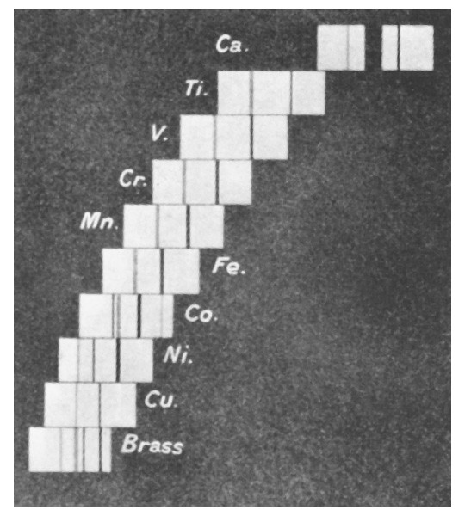
X-Ray Spectra
Moseley 1913
  X-ray emission is explained in terms of transitions in which e⁻ drop into orbits close to the atomic nucleus.
  Correlated frequencies to nuclear charges.
ν = A (Z – b)²
  Used to predict new elements (43, 61, 75) later discovered.
Notes:
43, 61 and 75 were discovered in 1937, 1945 and 1925 respectively.
Also proved the periodic law in the region from Z = 13 to 79, and that there could be NO other elements in this region.

Slide 8
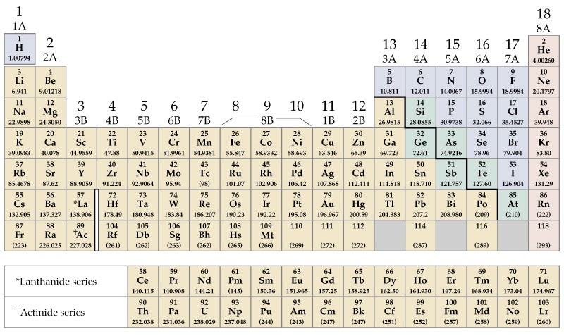
The Periodic table
Alkali Metals
Noble Gases
Alkaline Earths
Main Group
Halogens
Transition Metals
Main Group
Lanthanides and Actinides

Slide 9
10-2 Metals and Nonmetals and Their Ions
Metals
  Good conductors of heat and electricity.
  Malleable and ductile.
  Moderate to high melting points.
Nonmetals
  Nonconductors of heat and electricity.
  Brittle solids.
  Some are gases at room temperature.

Slide 10
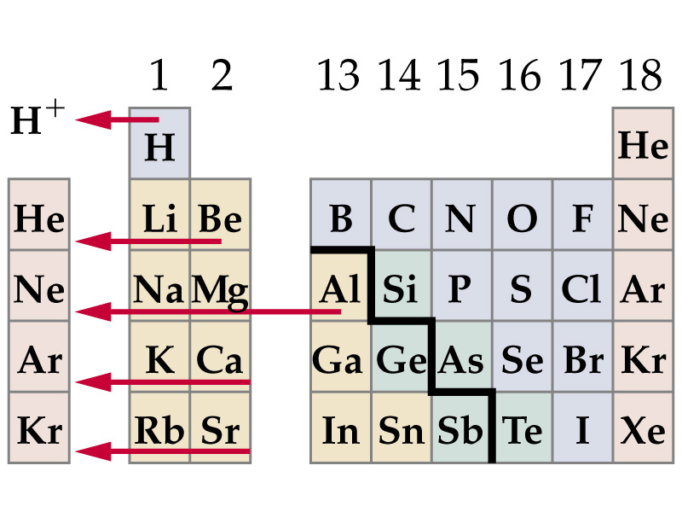
Metals Tend to Lose Electrons

Slide 11
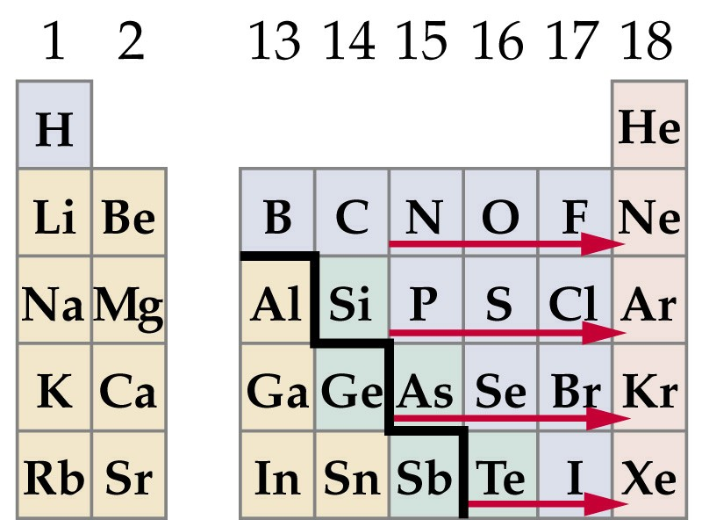
Nonmetals Tend to Gain Electrons

Slide 12
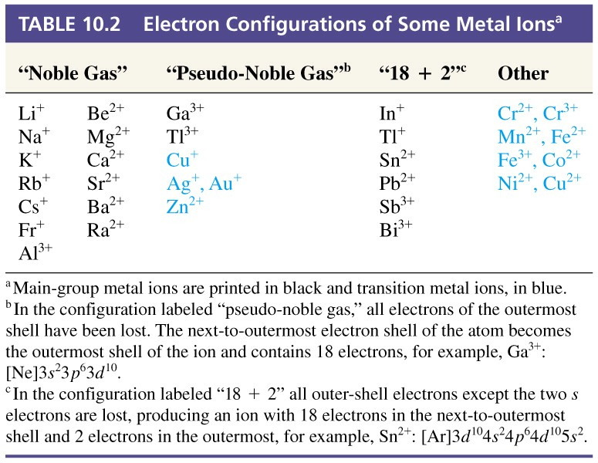
Electron Configuration of Some Ions

Slide 13
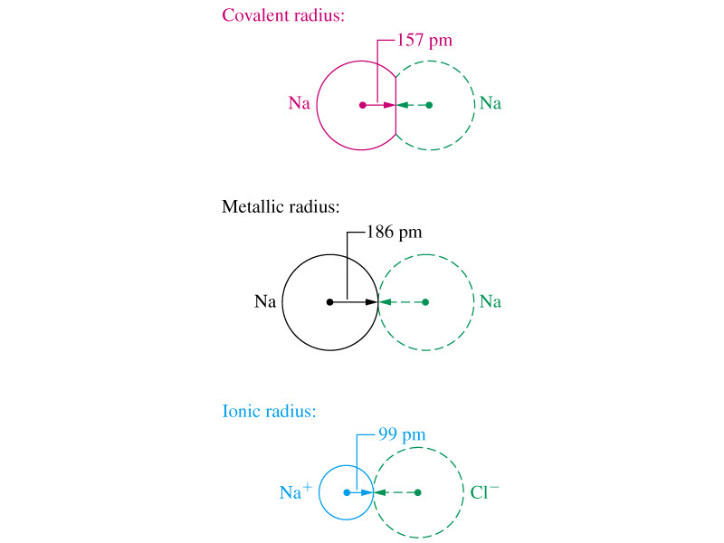
10-3 The Sizes of Atoms and Ions

Slide 14
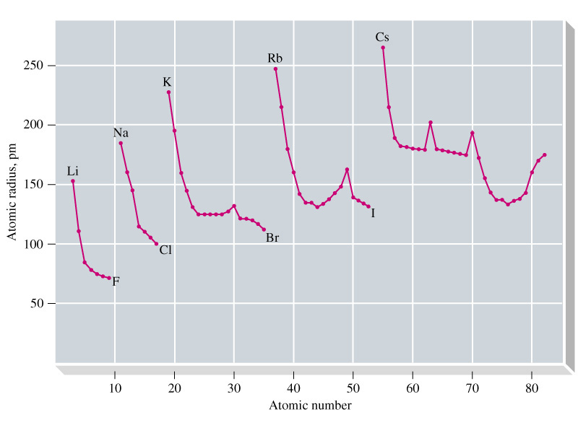
Atomic Radius
Notes:
Radii increase down a group.
Radii decrease across a period in the main group (Z_{eff} increases across main group elements).
Radii in Transition metals remain fairly constant except for a few spikes. Electrons go into an inner shell, thus participate in shielding the outer shell electrons from the increasing Z_{eff}.

Slide 15
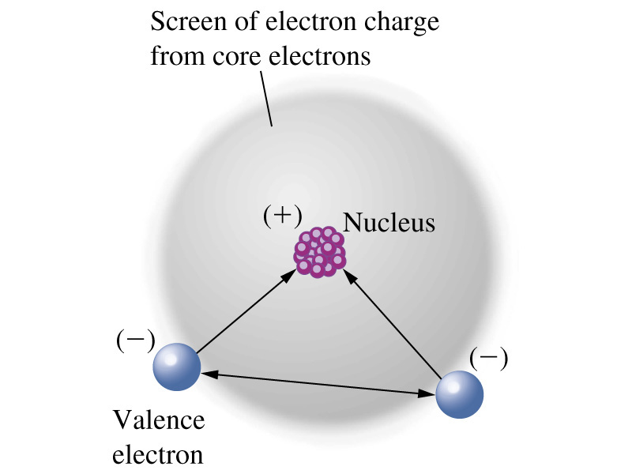
Screening and Penetration
Z_{eff} = Z – S
E_{n} = -
Z_{eff}²
R_{H}
n²
Notes:
Z_{eff} is effective nuclear charge.
E_{n} is orbital energy

Slide 16
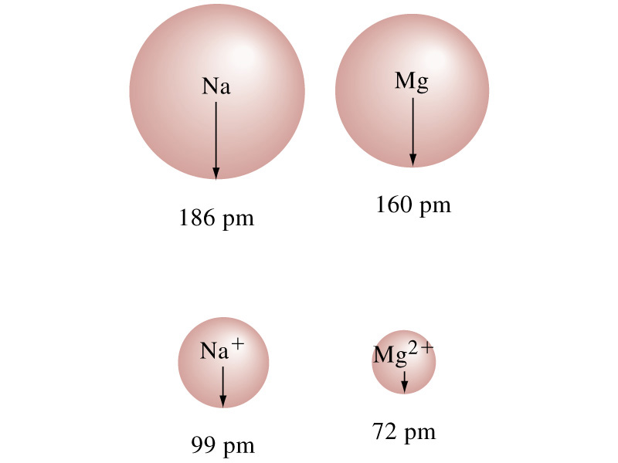
Cationic Radii

Slide 17
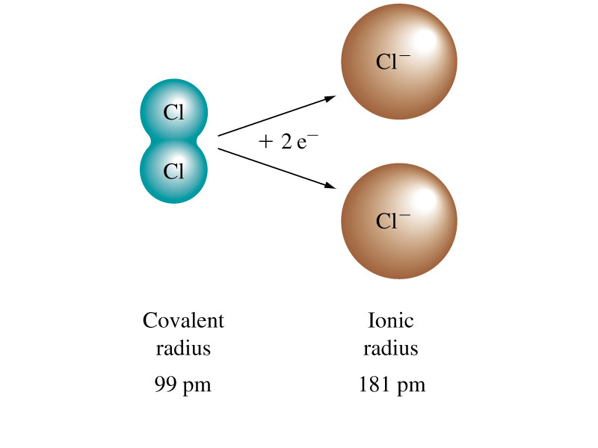
Anionic Radii

Slide 18
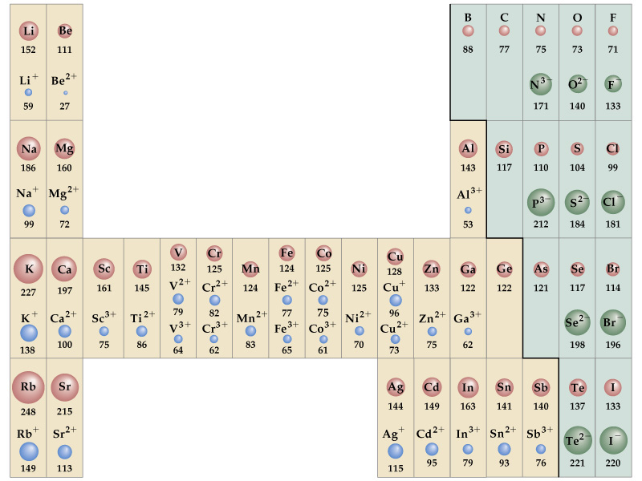
Atomic and Ionic Radii
Notes:
Knowdledge of atomic and ionic radii can be used to varycertain physical porperties.
Ex Na⁺ and Ca²⁺ ions. Glass is brittle and breaks easily. Replace surface Na⁺ by K⁺ and glass becomes shatter resistant.
Cr³⁺ in Al₂O₃ (about 1%) gives beautiful red colour (Ruby).

Slide 19
10-4 Ionization Energy
Mg(g) → Mg⁺(g) + e⁻ I₁ = 738 kJ
Mg⁺(g) → Mg²⁺(g) + e⁻ I₂ = 1451 kJ
Z_{eff}²
I = R_{H}
n²
Notes:
Ionization energy is the quantity of energy a gaseous atom must absorb so that an electron is stripped from it. The electron lost is the one most loosely held.

Slide 20
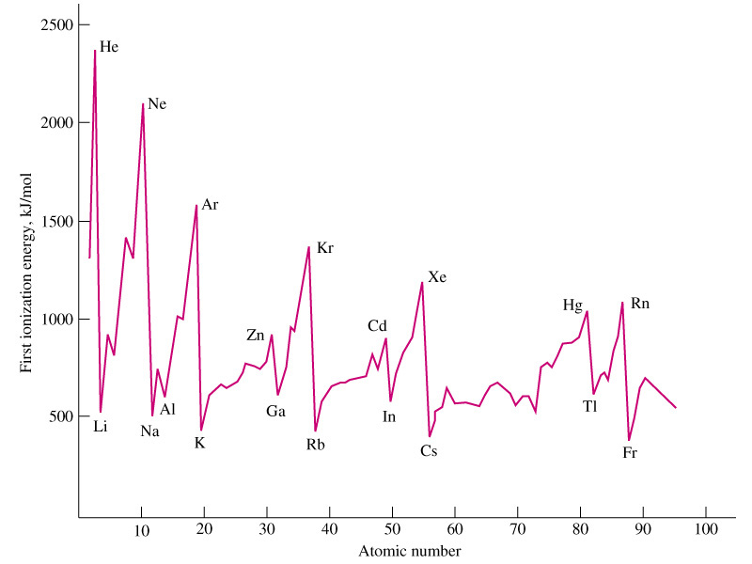
First Ionization Energy
Notes:
Ionization energies decrease as atomic radii increase.
Noble gases are the most difficult to ionize.
Alkali metals are the easiest to ionize.
Other trends are apparent and can be discussed better using specific examples (next slide)

Slide 21
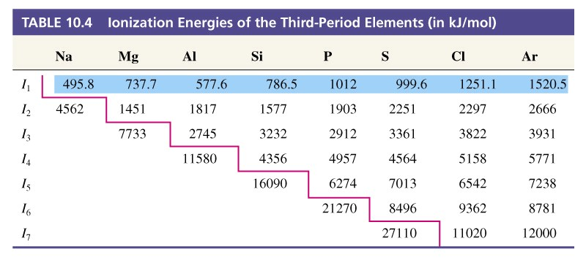
Table 10.4 Ionization Energies of the Third-Period Elements (in kJ/mol)
737.7
577.6
1012
999.6
1451
7733
I₂ (Mg) vs. I₃ (Mg)
I₁ (Mg) vs. I₁ (Al)
I₁ (P) vs. I₁ (S)
Notes:
Removing the third electon from Mg causes a large jump in I.
I₁ of Al less than Mg because s- electron is removed from Mg and p-electron is removed from Al.
I₁ of S is less than that of P. This is due to e⁻-e⁻ repulsion of the fourth electron.

Slide 22
10-5 Electron Affinity
F(g) + e⁻ → F⁻(g) EA = -328 kJ
F(1s²2s²2p⁵) + e⁻ → F⁻(1s²2s²2p⁵)
Li(g) + e⁻ → Li⁻(g) EA = -59.6 kJ

Slide 23
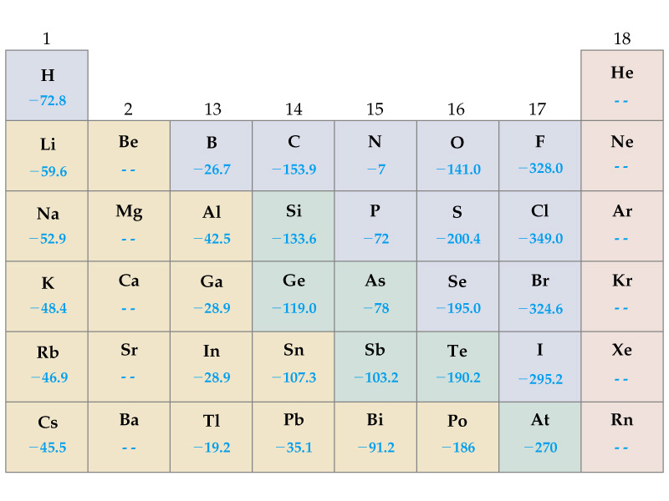
First Electron Affinities

Slide 24
Second Electron Affinities
O(g) + e⁻ → O⁻(g) EA = -141 kJ
O⁻(g) + e⁻ → O²⁻(g) EA = +744 kJ
Notes:
Gaseous O²⁻ is not likely. It is OK in Na₂O because of the energetically favorable electrostatic interactions.

Slide 25
10-6 Magnetic Properties
Diamagnetic atoms or ions:
  All e⁻ are paired.
  Weakly repelled by a magnetic field.
Paramagnetic atoms or ions:
  Unpaired e⁻.
  Attracted to an external magnetic field.

Slide 26
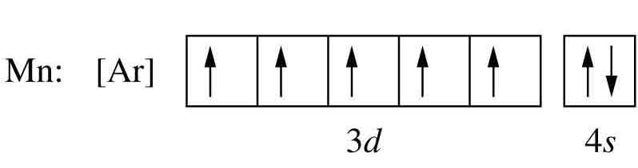
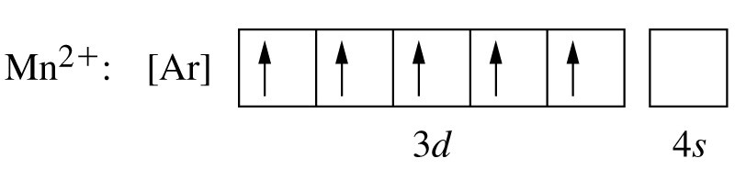
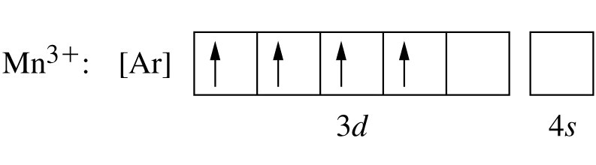
Paramagnetism

Slide 27
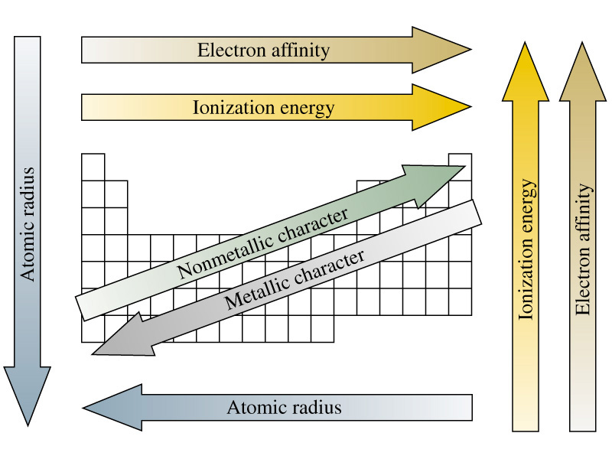
10-7 Periodic Properties of the Elements
Notes:
Metallic character corresponds to conductance of heat and electricity.

Slide 28
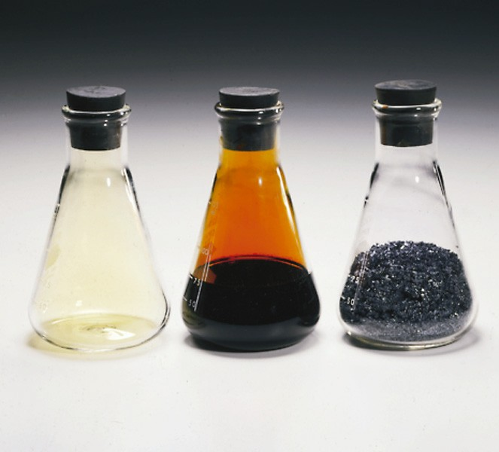
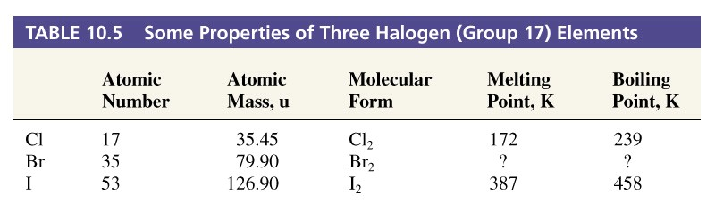
Boiling Point
?
?
266
332
Notes:
Average is 349 for mp
Average is

Slide 29
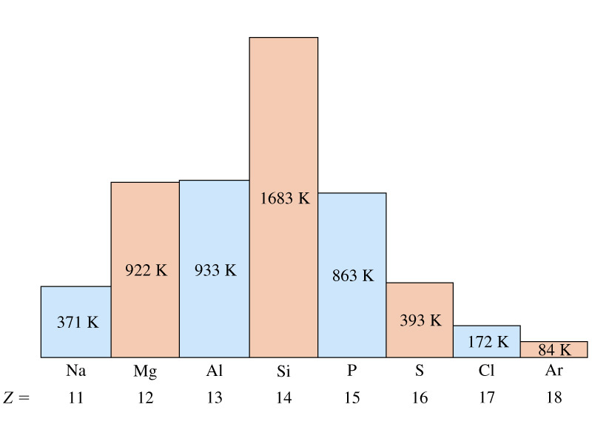
Melting Points of Elements
Notes:
Melting involves destruction of the orderly arrangement of atoms or molecules in a crystalline solid.
Melting point temperature depends on the strength of the attractive forces between atoms of molecules in the solid.
Na, Mg, Al Metallic bonds,
Si Covalent bonds, strong interatomic forces.
P₄, S₈, Cl₂ Discrete molecules, forces become weaker as you go across.

Slide 30
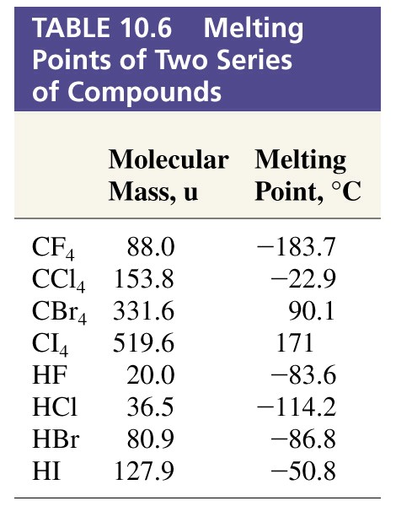
Melting Points of Compounds

Slide 31
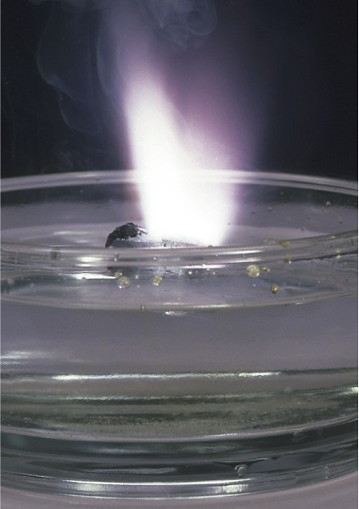
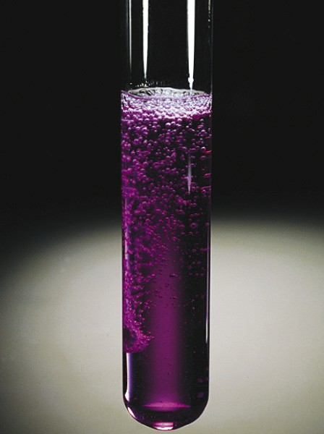
Reducing Ability of Group 1 and 2 Metals
2 K(s) + 2 H₂O(l) → 2 K⁺ + 2 OH⁻ + H₂(g)
I₁ = 419 kJ
I₁ = 590 kJ
I₂ = 1145 kJ
Ca(s) + 2 H₂O(l) → Ca²⁺ + 2 OH⁻ + H₂(g)
Notes:
K is representative of reactivity of Group 1, expect that a lower ionization energy should react more vigerously.
Ca is representative of reactivity of Group 2, expect that a higher ionization energy should react more slowly.
Ionization energy alone is an oversimlification. If differences in I are small then other factors must be taken into account.

Slide 32
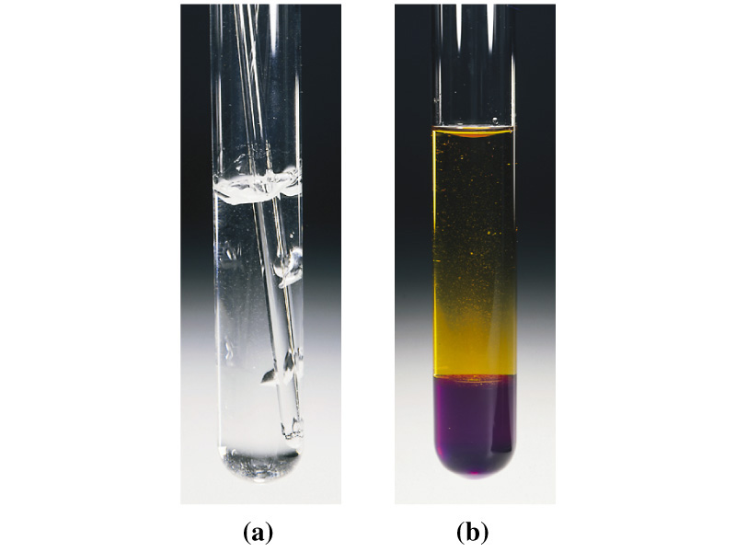
Oxidizing Abilities of the Halogens
2 Na + Cl₂ → 2 NaCl
Cl₂ + 2 I⁻ → 2 Cl⁻ + I₂
Notes:
Expect compounds with high electron affinity to be good oxidizing agents. So halogens should react vigorously with Na.
Cl has higher electron affinity than I, therefore the reaction should lie to the right.

Slide 33
Acid Base Nature of Element Oxides
Basic oxides or base anhydrides:
  Li₂O(s) + H₂O(l) → 2 Li⁺(aq) + 2 OH⁻(aq)
Acidic oxides or acid anhyhydrides:
  SO₂ (g) + H₂O(l) → H₂SO₃(aq)
Na₂O and MgO yield basic solutions
Cl₂O, SO₂ and P₄O₁₀ yield acidic solutions
SiO₂ dissolves in strong base, acidic oxide.

Slide 34

Focus on The Periodic Law and Mercury
Should be a solid.
Relativistic shrinking of s-orbitals affects all heavy metals but is maximum with Hg.

Slide 35
Chapter 10 Questions
1, 2, 18, 21, 27, 33, 39, 43, 51, 55

